Slide 1
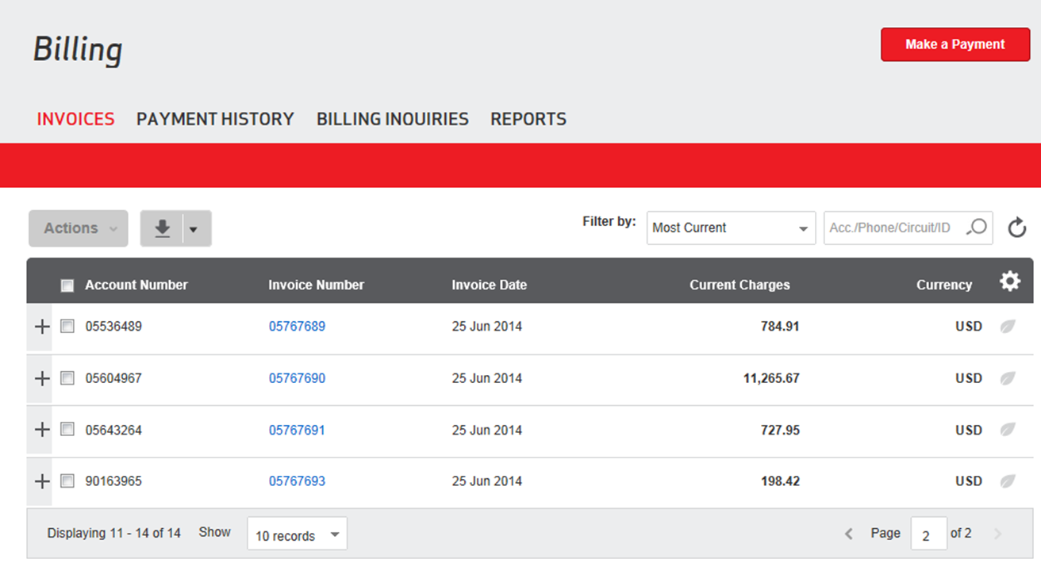
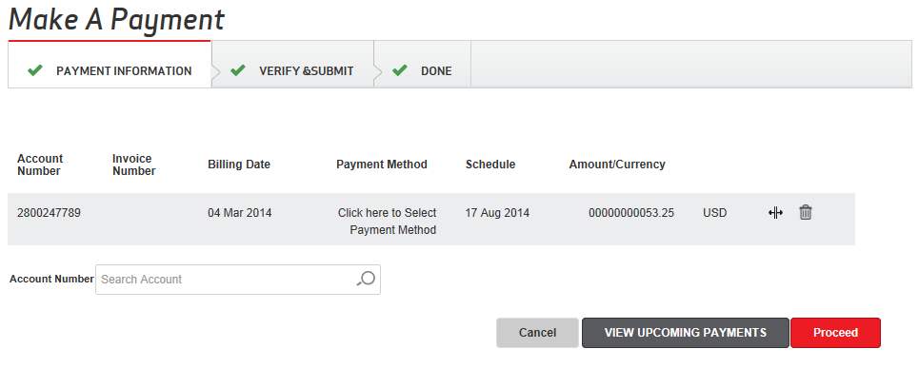
VEC 2.0- Billing
Project Objectives and Results
Progress
Phase:1 (Sep 27th) – UAT phase
Invoice home, Payments, Inquiries, Account summary
Archived invoices, Invoice images,
Change Billing Address, Manage Paper settings
Bill views (Wireless, VRD, IXPLUS, IBRS)
Phase:2 (Nov 14th) – Analysis in progress
Bill views (All flavors)
Adoption to smart Entitlements
Quick tasks
Phase:3 (2015)
Notification
GBR, Reporting
Downloads, Batch processes
Benefits
Highly intuitive design to enhance customer experience.
Single Action menu to navigate across key functions.
Bill views obtained through single click directly from invoice home.
Account Summary info integrated in the invoices grid.
Reduced steps taken for making payments from 7 to 2.
Reduction in manual routing of inquiries by 20%.
Q3
Pilot Launch Oct 2nd week
Q4
Q1
TBD
Phase 2 14-Nov
Enhanced usability & navigability to key actions/features

